Slide 1

DSC640 Project task 5
Presented by
Edris Safari
Notes:
Hello everyone and thank you for being here. This is the final deliverable for a study in data visualization.
In Data visualization, we turn data into pictures.
Pictures inform and help us make calculated decisions.

Slide 2
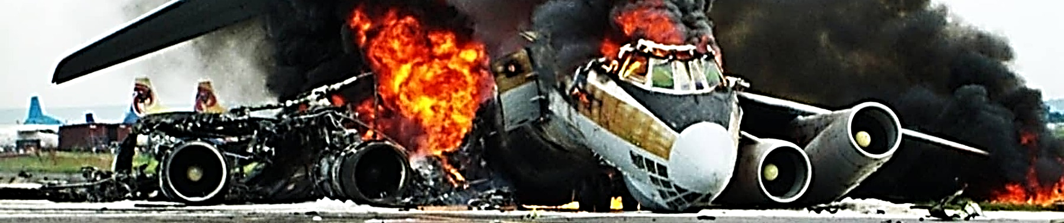
Notes:
You probably wonder why I am showing this ominous picture.

Slide 3

Notes:
That’s because I want to show this. A beautiful blue sky with a plane flying softly through it. I want to show you it’s not as bad as the media makes it out to be.
Today we are going to talk about airline travel and its safety.
When we hear about accidents with a lot of casualties. Or accidents with unknown and mysterious causes or just unexpected accidents, we and the media go crazy over safety issues. We make assumptions not based on facts.
In the next few minutes, I’m going to show you some pictures and graphs as we call it in data science. What’s data science? It’s the science of finding the truth using data.
I hope that using data, I can paint a different picture on airline travel and its safety. I’m going to show you accidents don't happen regularly, and fatalities have gone down over the years, and that traveling worldwide has increased in popularity and satisfaction.

Slide 4
Aviation Safety Network, Flight Safety Foundation
WorldBank Data:
https://data.worldbank.org/indicator/IS.AIR.PSGR?end=2020&start=1970&view=chart
Fatal and non-Fatal accidents from 1985 to 2014 by top 56 international airlines
US general Aviation Safety Data
US Carrier Safety Data
Number of miles traveled by all countries worldwide from 1980 to 2020
Airline passenger satisfaction
Notes:
As it is done in data science, we find data we can use.
I selected data from Aviation Safety Network and from the World Bank.
From Aviation Safety Network , we obtained information about accidents and incidents for a 30-year span from 1985 to 2014 and airline safety data
From world bank, we obtained customer satisfaction and total number of flights per year for over 80 countries for a 40-year span from 1980 to 2020.
The graphs that follow are representations of the data that were originally in excel or text files. They were free for public use.

Slide 5
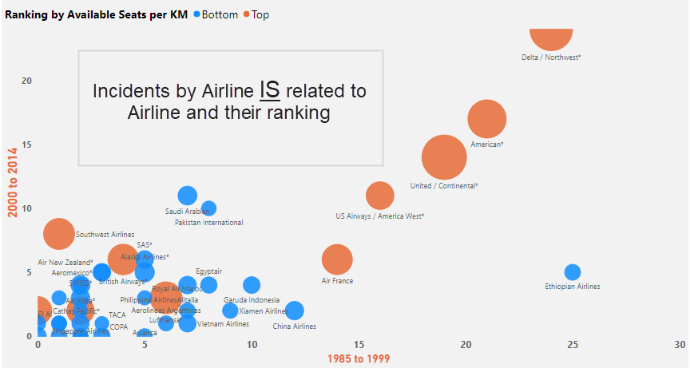
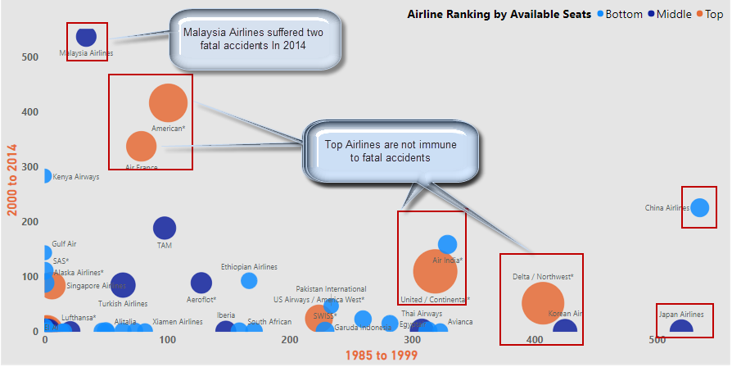
Notes:
This picture shows how we cannot predict fatal accidents. It shows that there’s no correlation at least among these airlines . The ones with bigger bubbles are the larger airlines.
Notice the Malaysian airline in 2014-a middle sized airline. The fatalities were related to the downing of flight 17 in June of 2014 and to the disappearance of its Flight 370 in March of the same year. While mysterious, the incidents were completely unrelated.
However, the Boeing 737 MAX passenger airliner was fund responsible to the death of 346 people in two separate crashes.
One was Lion Air Flight 610 on October 29, 2018 and the second one was Ethiopian Airlines Flight 302 on March 10, 2019. They were related, and related to mismanagement, and negligence. The planes were grounded.
This Picture shows the opposite. Incidents ARE predictable. It looks like the larger the airlines, the more incidents. Could this be just the mere fact that they fly more and have more planes and thus most susceptible to incidents,

Slide 6
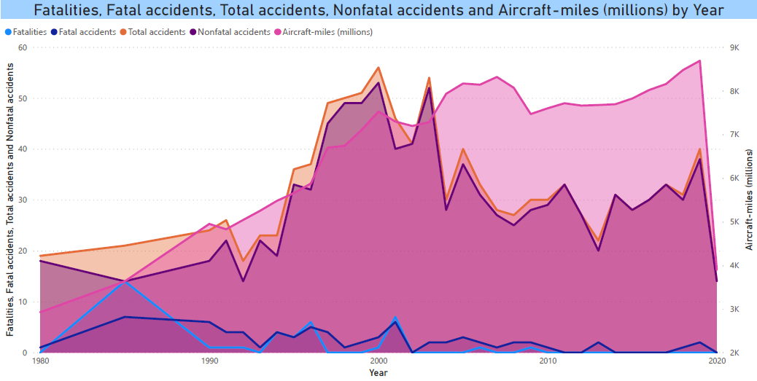
Notes:
This one gets a little deeper and shows more data. Notice the fatalities and fatal accidents on the bottom AND to the total accidents and nonfatal accidents and the aircraft miles on the top. While chances are high in nonfatal accidents, the rate in all categories except aircraft miles have been on the decline.

Slide 7
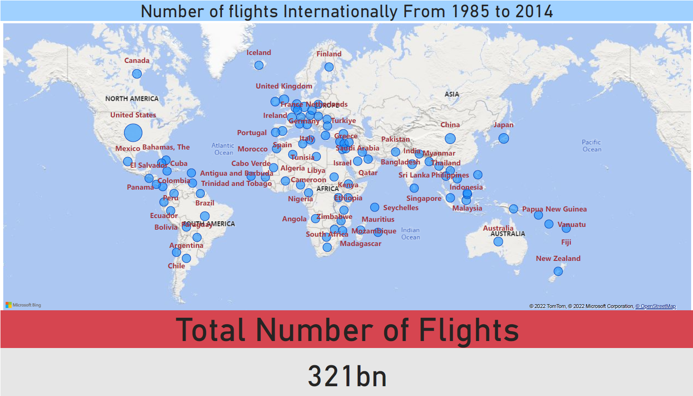
Notes:
This shows the density of flights world wide in these countries. Total number in the 30-year span reached 321 billion.

Slide 8
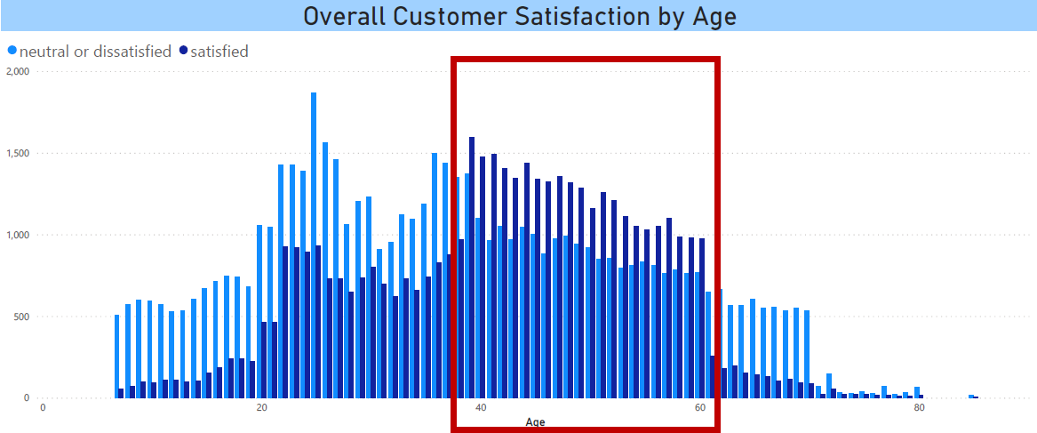
Notes:
This overall satisfaction was based on customer service and general satisfaction in the flight experience. The most frequent travelers were in their late 30’s and early 60’s. Their satisfaction rated higher then the younger and older population. That one is worth investigating…

Slide 9
.. And something to amaze you…
Notes:
And I am going to leave you with a moving graph.

Slide 10
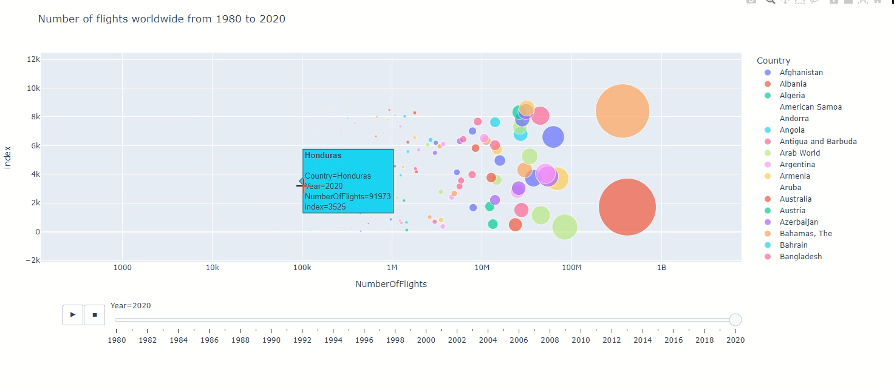
Notes:
This graph shows the progression in the number of flights by each country. < click play> The bubbles represent the total number of flights for each year from 1980 until 2020.
<Hover over some countries> Notice how the bubbles get larger for most countries.
The sudden decrease in 2019 and 2020 was during COVD.
<Go back a few year and play> However, as we see here , the bubbles have increased proportional to the size and economy of each country.
US, China, Japan, UK, and Russia are among the leaders.
Flying continues to be the most popular means of travel. Technology and regulations have helped make air travel SAFE.
So next time I seat in an airplane, I’ll relax and enjoy the flight.

Slide 11
THANK YOU

